Slide 1
Lab 10
Linear Regression

Slide 2
Linear Regression
Y (response) is a linear function of x (factors)
Used to find if there is an association between two variables
For example: Is there an association between:
Number of hours spent in studying and GPA?
Unemployment rate and GDP of a country?
Also used to predict response for a particular value of x
Estimate body fat % from BMI

Slide 3
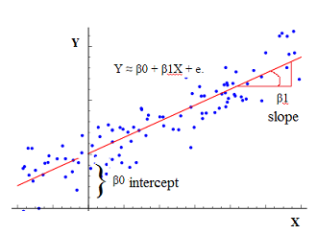

Linear Regression Equation
$Y=β_{0}+β_{1}x+ε$
$ε$ should be normal with mean 0 and variance $σ^{2}$
$β_{0}$ and $β_{1}$ estimated by method of least squares
Notes:
http://gerardnico.com/wiki/_media/data_mining/univariate_linear_regression.png

Slide 4
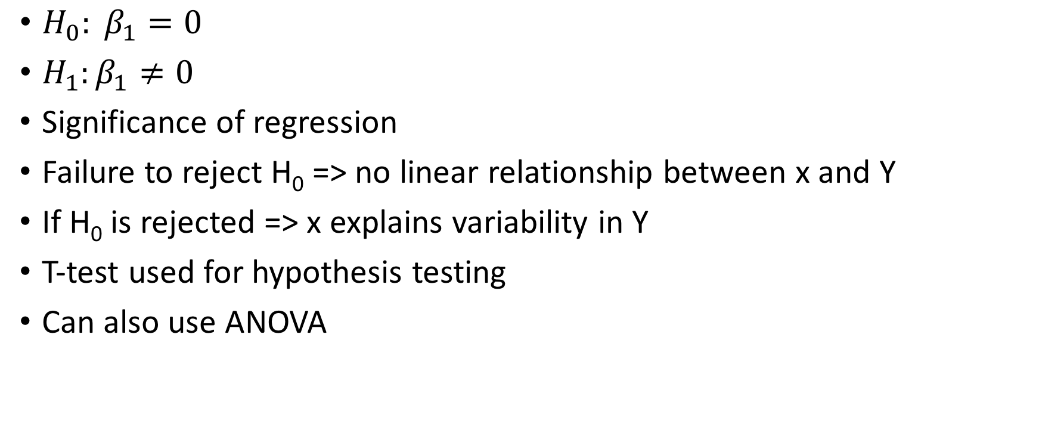
Test hypothesis
$H_{0}: β_{1}=0$
$H_{1}:β_{1}≠0$
Significance of regression
Failure to reject H₀ => no linear relationship between x and Y
If H₀ is rejected => x explains variability in Y
T-test used for hypothesis testing
Can also use ANOVA

Slide 5
Confidence intervals
Can be constructed for:
Slope and intercept
Mean response
Future response

Slide 6
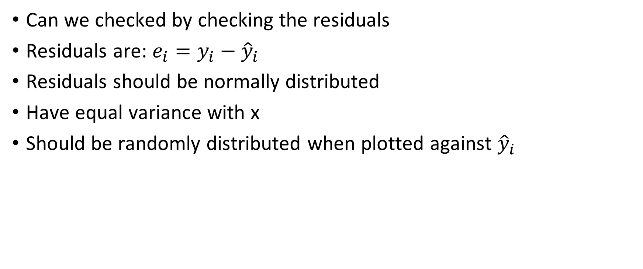
Model adequacy
Can we checked by checking the residuals
Residuals are: $e_{i}=y_{i}−{\hat{y}}_{i}$
Residuals should be normally distributed
Have equal variance with x
Should be randomly distributed when plotted against ${\hat{y}}_{i}$

Slide 7
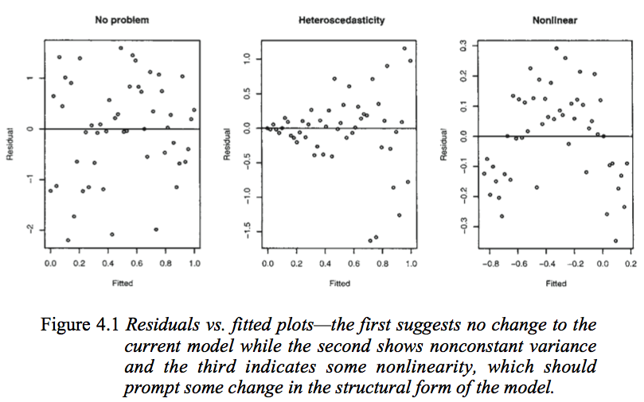
Model Adequacy
Notes:
https://i.stack.imgur.com/rtn7e.png

Slide 8
One interesting example
Estimate liver weight, helpful in liver transplantation
Given the body surface area (which is estimated from height and weight of a patient), liver weight estimated using the following:
W (in g) = 772*BSA (m²)
This linear regression formula was developed by using data from liver donors
Yoshizumi, T., et al. "A simple new formula to assess liver weight." Transplantation proceedings. Vol. 35. No. 4. Elsevier, 2003.

Slide 9
Extra exercise
Use the salt concentration versus roadway area data (Table 6-1), Page 300
Fit a linear model for X and Y and check for model adequacy
Fit a linear model for e^{X} and Y and check for model adequacy
Fit a linear model for X² and Y and check for model adequacy
Do you see any difference in plot of residuals in the 3 cases?

